Slide 1



E-COMMERCE PRODUCT RECOMMENDATION SYSTEM
MACHINE LEARNING & PREDICTIVE ANALYTICS
FINAL CLASS PROJECT
MAY 23. 2024
Internal use only

Slide 2



BUSINESS PROBLEM
An e-commerce website specializing in beauty products wants to enhance its user experience by developing a dynamic, personalized recommendation system. The system should not be static but should instead adapt to the evolving preferences of its users, providing tailored product suggestions based on user behavior and ratings.
GOALS
Create a recommendation engine that suggests products which these similar users have rated highly but the target user has not yet rated, ensuring personalized and relevant product recommendations.
Develop a method to identify the top 5 users similar to a given user based on their historical ratings, utilizing a well set recommendation system approach

Slide 3
EXPLORATORY DATA ANALYSIS (EDA)
Product Id
User Id
Rating
Year
Month
Normalized Rating
DATA DESCRIPTION
The dataset contains over 2 million customer reviews and ratings of beauty-related products sold on Amazon's website, with 2,023,070 rows. There are 1,210,271 unique users and 249,274 unique products, with ratings ranging from 1 to 5.
DATA
FEATURES
QUALITY CONCERNS
Quality concerns include the presence of outliers, as many users consistently give the highest rating (5), indicating potential bias or spammy behaviour. Data sparsity is another issue, with numerous products having very few ratings, challenging reliable conclusions and recommendation performance. Additionally, some users have only rated a few products, providing insufficient data to establish clear preference patterns. Addressing these issues is crucial to ensuring the robustness of the recommendation system.

Slide 4
ASSYMPTIONS & HYPOTHESIS
ASSUMPTIONS
HYPOTHESIS
Users with similar past ratings will likely have similar future preferences.
By identifying patterns in user ratings, the system can predict future preferences and make relevant recommendations.
Normalizing ratings can help mitigate biases where some users rate consistently higher or lower than others.
Adjusting ratings to a common scale allows for fairer comparison between users and more accurate similarity calculations.
The ratings given by users have enough variability to find meaningful similarities between users.
Range of ratings ensures that the similarity measures capture significant differences in user preferences, leading to accurate recommendations.
Popular products are likely to provide more reliable recommendations than less popular products.
Products with a higher number of ratings have more robust data, making them better candidates for reliable recommendations

Slide 5
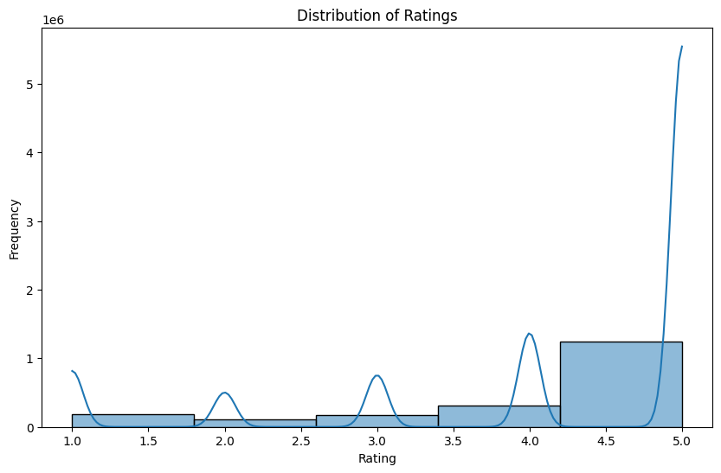
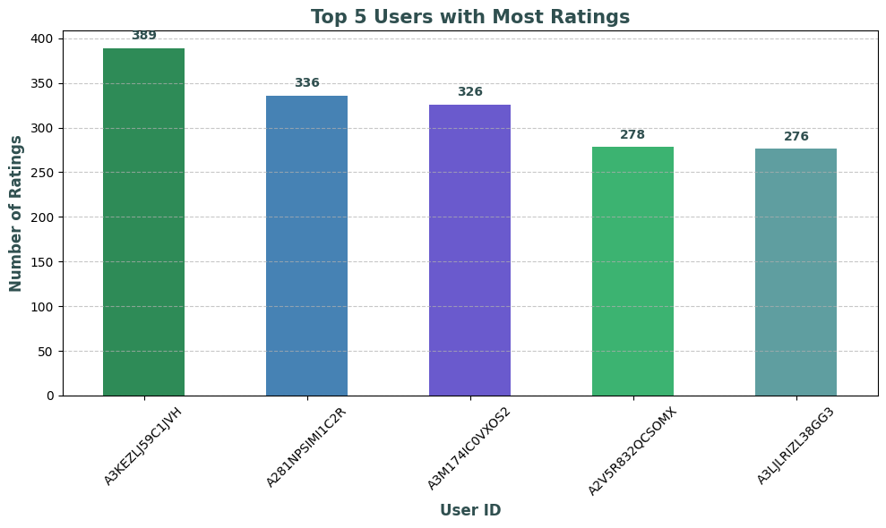
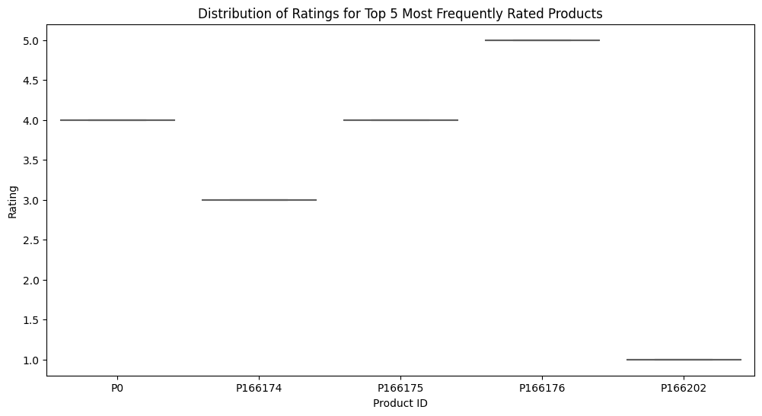
EXPLORATORY DATA ANALYSIS (EDA)
RATINGS DISTRIBUTIONS
TOP 5 USER
TOTAL RATING
TOP 5 USER
RATING BEHAVIOR
The distribution of ratings is skewed towards higher ratings, with the majority being 4.5 and above, indicating a potential positive bias that could affect the reliability of the recommendation system.
The top 5 most active users have provided between 276 and 389 ratings each, significantly influencing the dataset.
The distribution of ratings for the top 5 most frequently rated products shows that each product predominantly received a single rating value. This indicates a lack of variability in the ratings for these products, suggesting that users generally agree on the quality of these items.

Slide 6
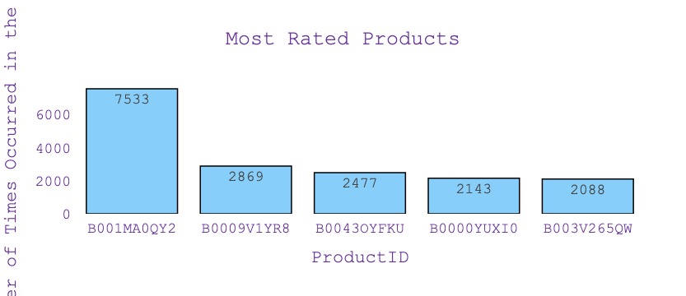
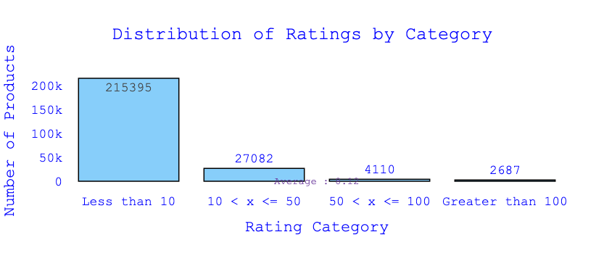
EXPLORATORY DATA ANALYSIS (EDA)
MOST RATED PRODUCTS
DISTRIBUTION RATINGS BY CATEGORY
The most rated product received 7533 ratings, significantly more than the others. The next most rated products have 2869, 2477, 2143, and 2088 ratings, respectively. This indicates a skewed distribution of user ratings, with a few products receiving the majority of attention.
the distribution of ratings by category, with a vast majority of products (215,395) receiving less than 10 ratings. There are 27,082 products with 10 to 50 ratings, 4,110 products with 50 to 100 ratings, and only 2,687 products with more than 100 ratings. This highlights that most products have very few ratings, indicating a high level of data sparsity.

Slide 7






FEATURE ENGINEERING & TRANSFORMATIONS
Timestamp Conversion
Label Encoding
Rating Normalization
Filtering Products by Ratings
Creation of User-Item Matrix:
Made the timestamp data more interpretable and useful for analysis.
Converted UNIX timestamps to readable date formats (Year, Month, Day) to facilitate time-based analysis and trends.
Prepared categorical data for ML algorithms that require numerical input.
So converted alphanumeric IDs to numeric values using label encoding, making the data suitable for similarity calculations and other numerical analyses.
Adjusted ratings to account for user-specific biases and standardize ratings across users.
Normalized user ratings by subtracting the average rating given by each user.
Focused on products with a substantial number of ratings to ensure reliable recommendations.
Filtered out products with fewer than 200 ratings, retaining only those products with a significant number of ratings.
Structured data for similarity calculations and collaborative filtering.
For which created a user-item matrix from the filtered ratings data to apply cosine similarity for identifying similar users.

Slide 8
MODEL SELECTION:
Autoencoder Model To Perform Collaborative Filtering
Data Preparation:
Training
1
Encoded user and product IDs using LabelEncoder.
Created a user-item matrix with users as rows and products as columns.
Split the data into training (80%) and testing (20%) sets.
The size of dataset has changed from 2023070 to 370511
3
Compiled the model with Adam optimizer and Mean Squared Error (MSE) loss function.
Trained the model for 100 epochs with a batch size of 256, using a shuffle strategy to improve generalization.
Validation performed on the test set to monitor model performance.
OVERFITTING
MSE: 0.573
Model Architecture:
Results
2
Encoder Layers :Dense layers with 128, 64, and 32 neurons, each followed by Batch Normalization and Dropout for regularization.
Decoder Layers: Dense layers with 64, 128 neurons, followed by Batch Normalization and Dropout.
4
Encoder Layers :Dense layers with 128, 64, and 32 neurons, each followed by Batch Normalization and Dropout for regularization.
Decoder Layers: Dense layers with 64, 128 neurons, followed by Batch Normalization and Dropout.

Slide 9
MODEL SELECTION:
SVD
Data Preparation:
Training
1
Filtered ratings data is first converted into a format suitable for the Surprise library. The data is loaded into Surprise format by specifying the rating scale, which ranges from 1 to 5. This is accomplished using the Reader class to parse the data, followed by the Dataset.load_from_df method to convert the DataFrame into a dataset.
3
The training process involves hyperparameter tuning to identify the best combination of hyperparameters based on the RMSE. After defining the parameter grid, GridSearchCV is used to find the optimal set of hyperparameters. The dataset is then split into training and testing sets in an 80-20 ratio.
OVERFITTING
RMSE: 1.1984
Model Architecture:
Results
2
Used Singular Value Decomposition (SVD) to perform collaborative filtering. To optimize the model, a grid of hyperparameters is defined for tuning. These hyperparameters include the number of latent factors (n_factors), the number of training epochs (n_epochs), the learning rate (lr_all), and the regularization term (reg_all).
4
To evaluate the performance of the tuned model, we use the test set and calculate the RMSE. The evaluation process involves predicting the ratings on the test set and comparing them with the actual ratings to compute the RMSE.

Slide 10

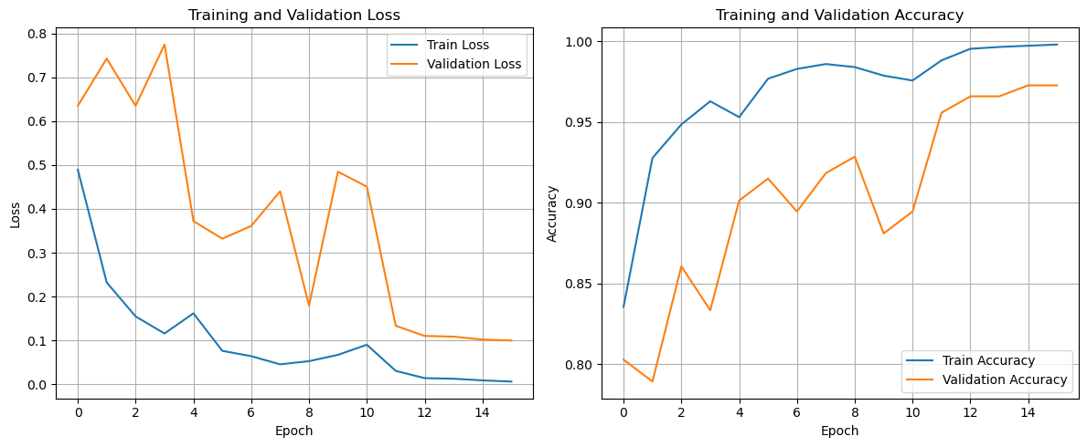
FINAL MODEL:
Collaborative Filtering - Using Cosine Similarity & KNN
Data Preparation:
Model Architecture:
1
Encoded user and product IDs using LabelEncoder.
Created a user-item matrix with users as rows and products as columns.
Split the data into training (80%) and testing (20%) sets.
The size of dataset has changed from 2023070 to 370511
2
User-Item Matrix Creation:
Pivot the dataset to create a user-item matrix where rows represent users and columns represent products. The values in the matrix are the normalized ratings.
Encoder Layers :Dense layers with 128, 64, and 32 neurons, each followed by Batch Normalization and Dropout for regularization.
Decoder Layers: Dense layers with 64, 128 neurons, followed by Batch Normalization and Dropout.
Cosine Similarity Calculation:
Compute the cosine similarity between users to identify how similar they are based on their product ratings.
Recommendations Generation:
Recommend products to the user based on the products rated highly by the top similar users, ensuring the recommended products are ones the current user has not interacted with.
Top Similar Users Identification:
For a given user, find the top 5 most similar users by sorting the cosine similarity scores in descending order.

Slide 11
FINAL MODEL:
Collaborative Filtering - Cosine Similarities between Users
EXPLANATION OF RECOMMENDATION MODEL
1
Input Parameters
2
User-Item Matrix
3
Mean Ratings
4
Filter &
Recommendation
Filters the mean ratings of similar users to include only the products that the current user has not rated.
Sorts these products by mean rating in descending order to prioritize higher-rated products, increasing the likelihood that the recommendations will be well-received.
user_id: The target user for whom we want to recommend products.
similar_users: The top 5 similar users to the target user.
similarity_table: The user-item matrix with normalized ratings.
top_recommendations: The number of top product recommendations to return (default is 5).
This step extracts data for products rated by the users who are similar to the target user. This helps us understand what products similar users are engaging with.
Filters the user-item matrix to include only the similar users. This ensures we're working with the right subset of data.
Computes the average rating for each product based on the ratings from the similar users. This helps to determine which products are generally preferred by the similar users.
Retrieves the current user's data and transposes it for easier filtering.
Identifies products that the current user has not rated (where rating is 0).
The dataset, containing 2,023,070 records, is divided into training (80%) and testing (20%) sets. | Training Data: 1,618,456 records | Testing Data: 404,614 records

Slide 12





TESTING MODEL USING TRAINING DATA
USER ID:
A2XVNI270N97GL
Selecting Users for Testing
Calculating Cosine Similarity
From the training data, a list of 100 users is selected for testing the recommendations.
Example selected users: ['User 1', 'User 2', ..., 'User 100']
Cosine similarity is calculated between the target user and all other users in the training data. EX:
| User ID | Similarity Score |
|----------|------------------|
| User 10 | 0.92 |
| User 27 | 0.89 |
| User 45 | 0.88 |
The dataset, containing 2,023,070 records, is divided into training (80%) and testing (20%) sets.
Training Data: 1,618,456 records
Testing Data: 404,614 records
User-Item Matrix for Training Data
Identifying a Target User for Testing
Generating Recommendations
A specific user is chosen from the list of selected users for testing.
Example target user: User A2XVNI270N97GL
Example:
Top 5 products: ['Product X', 'Product Y', 'Product Z', 'Product A', 'Product B']

Slide 13
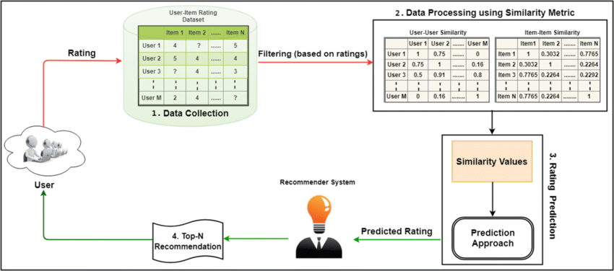
RESULTS AND LEARNINGS
FINAL RESULTS
PROs OF CF RECOMMENDATION
The memory-based CF technique used a rating system to forecast a user’s preferences by considering the likes of similar users or ‘neighbors.’ Only the user-item matrix is used in memory-based collaborative filtering to provide top 5 products with the latest recommendations with average similarity score of 82%
Versatility - CF engines are more flexible than other search engines as you can use them in any domain, and, with some adjustments, they might also offer recommendations across multiple domains.
Highly Efficient - Users building connections across subspaces in the product space may make CF engines more efficient and reliable at guiding the user in overcoming the "filter bubble" challenge.
Recommending Top 5 Products According to Past Ratings
CONs OF CF RECOMMENDATION
Data sparsity is a significant drawback of collaborative filtering . It often leads to the cold start problem, highlighting the challenges in making recommendations when the users or the products are new
Extensibility- Traditional CF algorithms typically experience significant scaling issues. Collaborative algorithms will tend to perform worse when the number of users grows and the volume of data expands because of the sheer volume of data growth.

Slide 14


FUTURE WORK
User Labels &
Demographics
Integrate Search
History
Advanced
Recommendation
Models
Expand to
Multiple Domains
Incorporate user information such as age, gender, and preferences for more personalized recommendations.
Use users' search history and behavioral data like click-through rates and browsing patterns to refine recommendations.
Implement advanced models like Matrix Factorization, Neural Collaborative Filtering (NCF), and Variational Autoencoders (VAE) to improve recommendation accuracy.
Incorporate data from multiple domains (e.g., books, electronics, apparel) to provide comprehensive recommendations across different product categories.
https://github.com/praveennmohankumar/E-commerce-recommendation-system/tree/main

